Slide 1


Tech ABC Corp - HR Database
[Student Name & Date]

Slide 2
How to use this Template
This is to serve a handy reference when completing your project
All work should be completed in the Jupyter Notebook environment provided by Udacity
Keep written responses succinct. Most questions can be answer with a short list or a few sentences. Essay like answers not required.
Please reference the IT Best Practices file when answering some of the technical questions
Remove this slide

Slide 3
Business Scenario
Business requirement
Tech ABC Corp saw explosive growth with a sudden appearance onto the gaming scene with their new AI-powered video game console. As a result, they have gone from a small 10 person operation to 200 employees and 5 locations in under a year. HR is having trouble keeping up with the growth, since they are still maintaining employee information in a spreadsheet. While that worked for ten employees, it has becoming increasingly cumbersome to manage as the company expands.
As such, the HR department has tasked you, as the new data architect, to design and build a database capable of managing their employee information.
Dataset
The HR dataset you will be working with is an Excel workbook which consists of 206 records, with eleven columns. The data is in human readable format, and has not been normalized at all. The data lists the names of employees at Tech ABC Corp as well as information such as job title, department, manager's name, hire date, start date, end date, work location, and salary.
IT Department Best Practices
The IT Department has certain Best Practices policies for databases you should follow, as detailed in the Best Practices document.

Slide 4
Step 1
Data Architecture Foundations

Slide 5
Step 1: Data Architecture Foundations
Hi,
Welcome to Tech ABC Corp. We are excited to have some new talent onboard. As you may already know, Tech ABC Corp has recently experienced a lot of growth. Our AI powered video game console WOPR has been hugely successful and as a result, our company has grown from 10 employees to 200 in only 6 months (and we are projecting a 20% growth a year for the next 5 years). We have also grown from our Dallas, Texas office, to 4 other locations nationwide: New York City, NY, San Francisco, CA, Minneapolis, MN, and Nashville, TN.
While this growth is great, it is really starting to put a strain on our record keeping in HR. We currently maintain all employee information on a shared spreadsheet. When HR consisted of only myself, managing everyone on an Excel spreadsheet was simple, but now that it is a shared document I am having serious reservations about data integrity and data security. If the wrong person got their hands on the HR file, they would see the salaries of every employee in the company, all the way up to the president.
After speaking with Jacob Lauber, the manager of IT, he suggested I put in a request to have my HR Excel file converted into a database. He suggested I reach out to you as I am told you have experience in designing and building databases. When you are building this, please keep in mind that I want any employee with a domain login to be have read only access the database. I just don't want them having access to salary information. That needs to be restricted to HR and management level employees only. Management and HR employees should also be the only ones with write access. By our current estimates, 90% of users will be read only.
I also want to make sure you know that am looking to turn my spreadsheet into a live database, one I can input and edit information into. I am not really concerned with reporting capabilities at the moment. Since we are working with employee data we are required by federal regulations to maintain this data for at least 7 years; additionally, since this is considered business critical data, we need to make sure it gets backed up properly.
As a final consideration. We would like to be able to connect with the payroll department's system in the future. They maintain employee attendance and paid time off information. It would be nice if the two systems could interface in the future
I am looking forward to working with you and seeing what kind of database you design for us.
Thanks,
Sarah Collins
Head of HR

Slide 6
Data Architect Business Requirement
Purpose of the new database:
What is the business partner requesting
Describe current data management solution:
What is the current method data storage/management
Describe current data available:
What data does the business currently have available
Additional data requests:
Does the user have future data requests
Who will own/manage data
What department will own / manage the data in the database
Who will have access to database
List user types that will have access; also list any restrictions to access.

Slide 7
Data Architect Business Requirement
Estimated size of database
List the size of the database in terms of numbers of rows. Business users often understand row or column size instead of GBs or MBs
Estimated annual growth
List any expected growth to the data
Is any of the data sensitive/restricted
List any data that may be sensitive or restricted from particular users

Slide 8
Data Architect Technical Requirement
Justification for the new database
Provide at least two justifications for building a database
Database objects
List the database objects (tables, views, special procedures) that will be created for the database.
Hint - you may want to circle back to this answer after completing the logical ERD in step 2.
Scalability
Should replication or sharding be used to ensure scalability based on user needs
Flexibility
Describe measures taken to ensure future data integration if needed
Storage & retention
Storage (disk or in-memory): check IT best practices document
Retention: how long does the data have to be kept for?
Backup
IT Best Practices document lists Backup schedule requirements

Slide 9
Step 2
Relational Database Design

Slide 10
Step 2: Relational Database Design
This step is where you will go through the process of designing a new database for Tech ABC Corp's HR department. Using the dataset provided, along with the requirements gathered in step one, you are going to develop a relational database set to the 3NF.
Using Mermaid, you will create 3 entity relationship diagrams (ERDs) to show how you developed the final design for your data.
Mermaid code should be entered into a Markdown cell. Once cell is executed, the diagram should appear

Slide 11
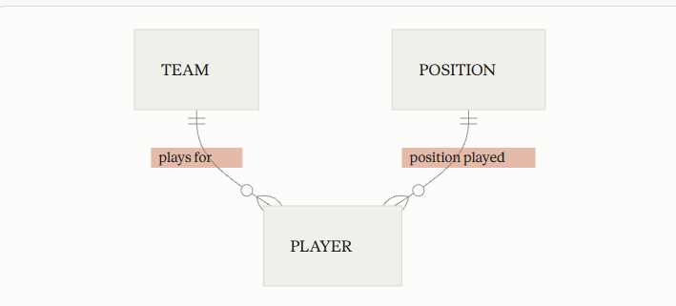
ERD
Conceptual
This is the most general level of data modeling. At the conceptual level, you should be thinking about creating entities that represent business objects for the database. Think broadly here. Attributes (or column names) are not required at this point, but relationship lines are required (although Crow's foot notation is not needed at this level). Create at least three entities for this model; thinking about the 3NF will aid you in deciding the type of entities to create.

Slide 12
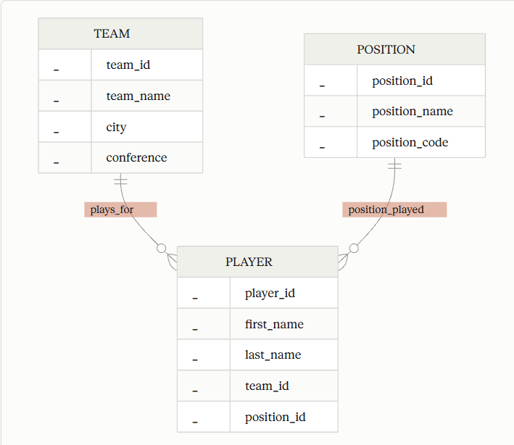
ERD
Logical
The logical model is the next level of refinement from the conceptual ERD. At this point, you should have normalized the data to the 3NF. Attributes should also be listed now in the ERD. You can still use human-friendly entity and attribute names in the logical model, and while relationship lines are required, Crow's foot notation is still not needed at this point.

Slide 13
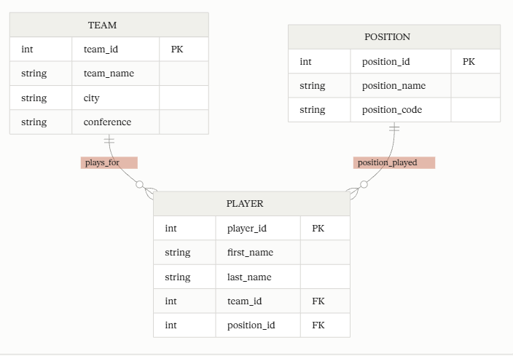
ERD
Physical
The physical model is what will be built in the database. Each entity should represent a database table, complete with column names and data types. Primary keys and foreign keys should also be represented here. Primary keys should be in bold type with the (PK) designation following the field name. Foreign keys should be in normal type face, but have the designation (FK) after the column name. Finally, in the physical model, Crow's foot notation is important.

Slide 14
Step 3
ETL Process/
Data Contract

Slide 15
Step 3: ETL Process/Data Contract
In this step you will build a complete data ingestion pipeline from scratch. You will read employee data from an Excel file, validate it against a JSON data contract you define, and load only the rows that pass validation into a landing table in your AWS database.
You will complete five steps in order:
Define a JSON data contract for five employee columns
Write Python code to read the Excel file
Write Python code to validate each row against the contract
Connect to your AWS database and create a landing table
Push validated rows into the landing table

Slide 16
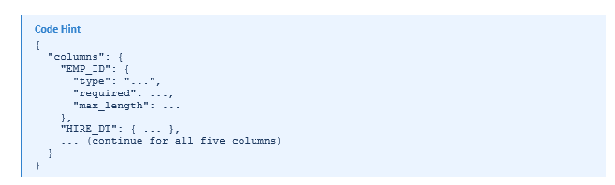
JSON
JSON Contract
Create a file called data_contract.json. Your contract must define rules for exactly these five columns:
EMP_ID — a required string with a maximum length of 20 characters
HIRE_DT — a required date value in YYYY-MM-DD format
JOB_TITLE — a required string with a maximum length of 100 characters
DEPARTMENT — a required string with a maximum length of 100 characters
LOCATION — a required string with a maximum length of 100 characters
JSON structure guidance
Your contract should be a JSON object with a top-level key called "columns". Each column name is a key inside "columns", and its value is an object containing the rules for that column. At minimum, include: type, required, and max_length (where applicable)

Slide 17
Data Load / Validation
Using Python, create a code block that loads Excel file into memory.
Hint: Pandas and Openpxl are preloaded in your environment.
Write a validation function that accepts a single row of data and the loaded contract, checks the row against every rule, and returns whether the row passed or failed — and if it failed, why.
After defining the function, loop through every row in your DataFrame and call it. Collect rows that pass into one list and rows that fail into another. At the end, print a summary showing how many rows passed and how many were rejected.
Only load records that pass validation.
Validation rules to implement
Your function must check each of the following for every column in the contract:
Required check — if required is true, the value must not be null, empty, or blank
Max length check — for string columns, the value must not exceed max_length characters
Date check — for date columns, the value must be parseable as a valid date

Slide 18
Connect to AWS
The Solution notebook comes prepopulated with the code needed to connect to your AWS database.
Remember to go to the Cloud Resource tab to obtain your credentials.
Once connected, build a landing table in your database that can accept the validated records loaded from the Excel file.
Insert Excel data into the table.
ONLY INSERT VALIDATED RECORDS INTO THE TABLE.

Slide 19
Step 4
Create A Physical Database

Slide 20
Step 4: Create A Physical Database
In this step, you will be turning your database model into a physical database.
You will:
Create the database using SQL DDL commands
Populate tables from Landing Table created in Step 4
Answer a series of questions using CRUD SQL commands to demonstrate your database was created and populated correctly

Slide 21
DDL / DML
Create a Python DDL SQL script capable of building the database you designed in Step 2
Build all tables you designed in step 2, make sure to including Primary and Foreign Keys.
Once the tables are built, use SQL scripting (via Python) to populate the tables with the data you stored in your landing table.

Slide 22
CRUD
Question 1: Return a list of employees with Job Titles and Department Names
Question 2: Insert Web Programmer as a new job title
Question 3: Correct the job title from web programmer to web developer
Question 4: Delete the job title Web Developer from the database
Question 5: How many employees are in each department?
Question 6: Write a query that returns current and past jobs (include employee name, job title, department, manager name, start and end date for position) for employee Toni Lembeck.
Question 7: Describe how you would apply table security to restrict access to employee salaries using an SQL server.

Slide 23
Step 4
Above and Beyond (optional)

Slide 24
Step 4: Above and Beyond
This last step is called Above and Beyond. In this step, I have proposed 3 challenges for you to complete, which are above and beyond the scope of the project. This is a chance to flex your coding muscles and show everyone how good you really are.
These challenge steps will bring your project even more in line with a real-world project, as these are the kind of “finishing touches” that will make your database more usable. Imagine building a car without air conditioning or turn signals. Sure, it will work, but who would want to drive it.
I encourage you to take on these challenges in this course and any future courses you take. I designed these challenges to be a challenge to your current abilities, but I ensured they are not an unattainable challenge. Remember, these challenges are completely optional - you can pass the project by doing none of them, or just some of them, but I encourage you to at least attempt them!

